Slide 1
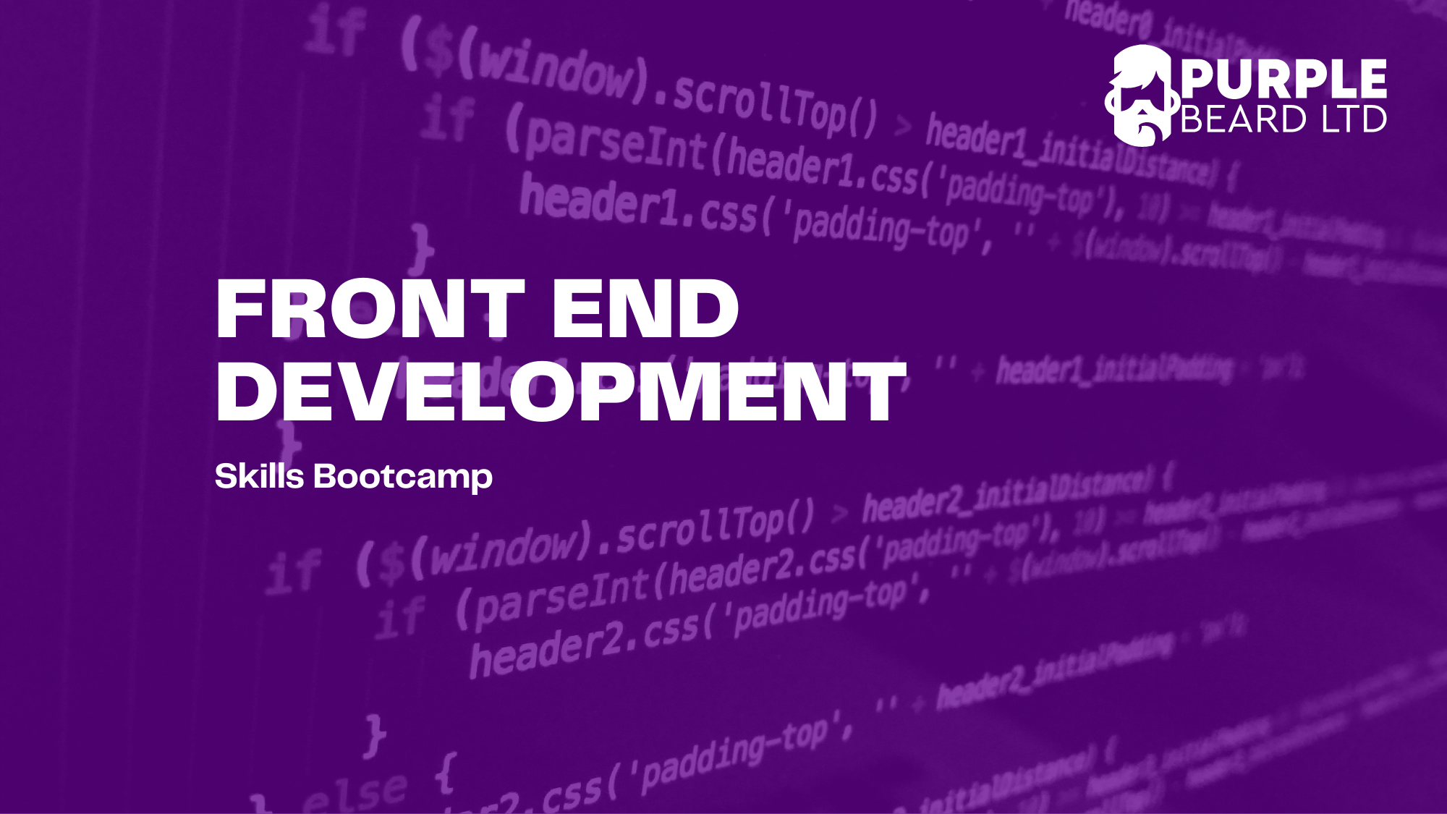
JavaScript 3

Slide 2


Slide 3
What is the DOM?
The Document Object Model
You can see the DOM when you go to Chrome and expect
We can use JavaScript to manipulate the DOM by deleting, adding and changing elements

Slide 4
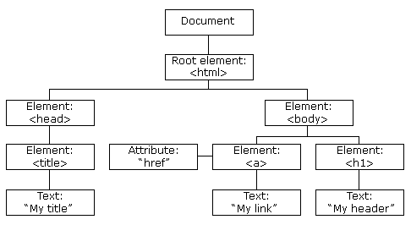
What does the DOM look like?
The DOM is made up of a tree of objects which we call nodes. You can see these nodes by typing Document into the console.

Slide 5
Live Coding: The Window Object and the Document Object Model
The Window Object
Window height, width and Location
The Document Object Model
Looking around the document object with "document." head, body URL, links, paragraphs etc.

Slide 6
Live Coding: Query Selector
Query selector
Using different CSS selectors to select elements
Text context

Slide 7
Query Selector Exercise
Given the boiler plate use query selector console log the following items on the page:
The text Content of the H1 element
The text content of the id “Hero”
The text content of the first instance of the class “list”
Add some text to the p tag with the id “dynamic-text”

Slide 8
Live Coding: Query Selector All
Query selector All
Node lists
Using square brackets with node lists and accessing the length property
Using for each to log and set text content
Converting node lists to arrays with the spread operator

Slide 9
Query Selector All Exercise
Given the boiler plate use query selector to console log the following items on the page:
The second p tag
All of the list items
The text content of the third instance of the class “list”
The length of the list

Slide 10
Live Coding: InnerHTML, Text Content and Value
Inner HTML
Inner HTML vs text content and security issues with user input
Value

Slide 11
Live Coding: Class List and Styles
Class list add, remove, toggle
Adding classes to node arrays with forEach
Adding styles syntax
Kebab-case vs camelCase
Using .style to display none

Slide 12
Inner HTML Exercise
Class List exercise: Add Dark Mode
Create a simple HTML page with a div with an id of dynamicContent
Create an array of your favourite foods
Use JavaScript and innerHTML to add a list to the page of your favourite foods using forEach .
Continue with your inner HTML exercise adding a style sheet with a class of “darkMode”. The class should set the background color to black and the text to white.
Use add class list to add the dark mode class to the body of your page.

Slide 13
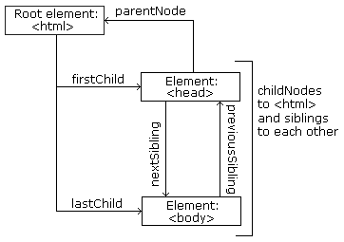
How do we move about the DOM?

Slide 14
Live Coding: Traversing the DOM
How to traverse the DOM
childNodes, children, parentNode, ParentElement
Previous siblings, next siblings
How log node elements and to change their text content

Slide 15
Live Coding:Appending and Prepending
Appending
Prepending
InsertAdjacentHTML
Using forEach to insert list items from an array

Slide 16
Creating new Nodes Exercise
Go to MDN docs and complete the Active learning: Basic DOM manipulation exercise
Carry on further down the page and complete the Creating and placing new nodes exercise

Slide 17
Live Coding: Event Listeners
Event Listener syntax
Event, event.currentTarget, event.currentTarget.textContent
Using Event listeners with buttons to show and hide text

Slide 18
Live Coding: Event Listeners II
Adding and removing classlists with event listeners
Toggling classlist with event listeners

Slide 19
Live Coding: Event Listeners III –Hamburger Menu
Building a simple Hamburger Menu with Event Listeners

Slide 20
Live Coding: Event Listeners IV - Accordion
Building a simple Accordion with Event Listeners
Using forEach to add event listeners

Slide 21
Live Coding: Event Listeners V - Forms
Event listers triggered on submit, keyup, blur, focus
Prevent default

Slide 22
Event Listener Exercise: Collapsible Content
Create a HTML file with a button and a div with an id of dynamic content.
Add an event listener so that when you press the button the text content of the "dynamic content" changes from show to hide or vice versa.
You should use query selector and class list toggle to complete this exercise

Slide 23
Eve/* this hides the button itself */
nt Listener Exercise: Password Validation
The user needs to enter a password at least 8 characters.
Create a HTML file with a username and password input
Add an event listener which console logs whether the password is allowed when the form is submitted

Slide 24
External Exercise: Shopping List exercise
Go to MDN docs and complete the exercise Active learning: A dynamic shopping list

Slide 25
Event Listener Exercise: Currency Converter
Create a simple pounds to dollars currency converter.
First start with a form with a number input and a submit button.
When submit is pressed the currency conversion should appear in a text box below.
You should use an event listener with a simple maths operation.

Slide 26
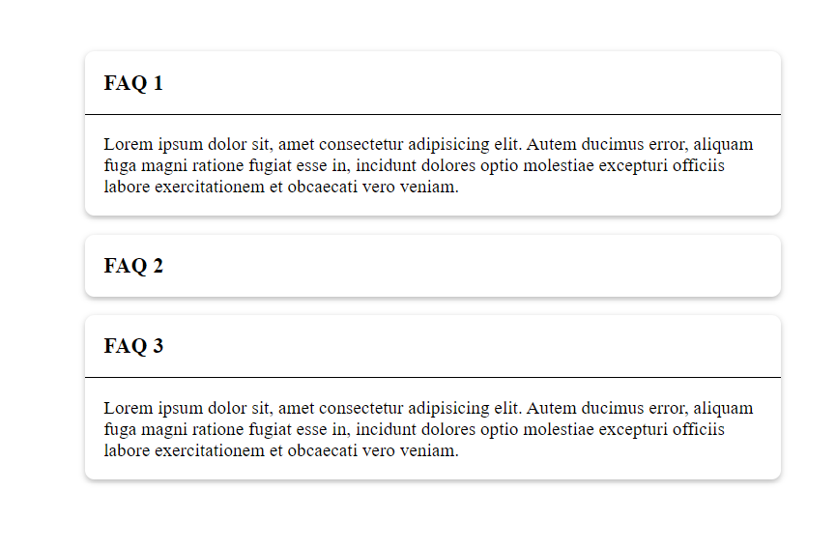
Event Listener Exercise: Create Your Own Accordion
Follow the recording of today's lecture to create your own customised Accordion.
Push your Accordion to GitHub and share your project with the Channel.

Slide 27
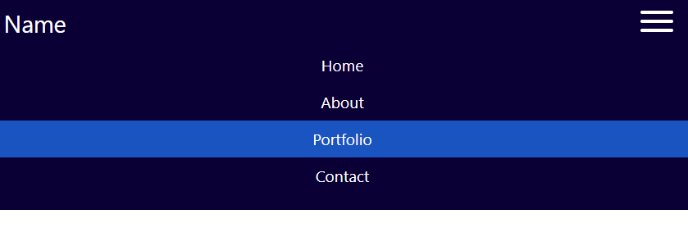
Event Listener Exercise: Add a Hamburger menu to your Portfolio Website
Follow the recording of todays lecture to add a hamburger menu to your portfolio

Slide 28
Live Coding 30: Local Storage
Local Storage: set item/ get item
Session Storage : set item/get item

Slide 29
Exercise Session Storage
Create a form with three inputs. For example: firstname, lastname, date of birth and email.
On submit store the data from the form in session storage
Console log the stored data
Part 2
Create a button which when clicked retrieves the data from session storage and shows the data in a div.

Slide 30
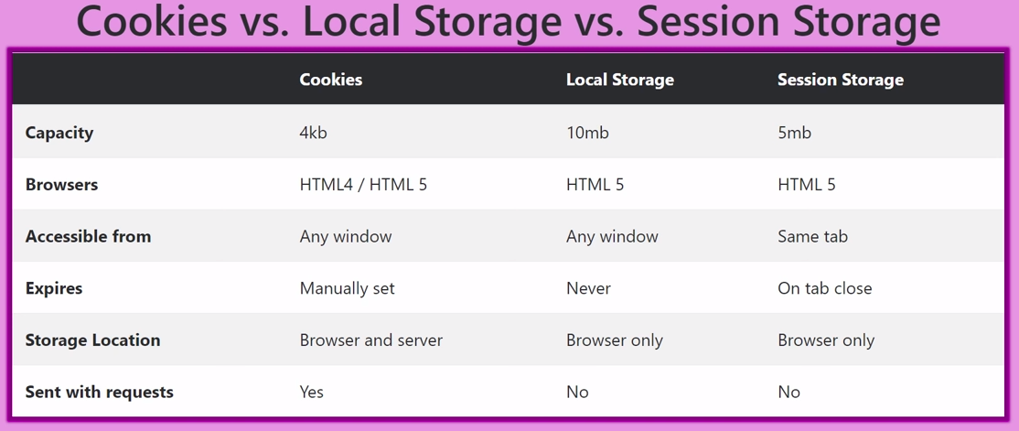

Slide 31
Homework
Finish the exercises for this week
Add a responsive hamburger menu to your website using JavaScript and add it to your GitHub and share the link on the Teams Assignment.
If you get suck ask a question in the help-code channel

Slide 32
Mid-Course Project!
For your Mid-course Project you will need to build a web app or website that utilises JavaScript logic (think if statements) and event listeners. You also should also use CSS to make it responsive. Don't worry too much what it looks like at this stage you can always add styling later. The focus is on creating something which is responsive and uses JavaScript.
You can do whatever you like – have some fun!
We would like you to message your TA plan for the Project by the next lesson. You should include in your plan a minimum viable product(MVP) which will be the basics it will take to get your project working. And then a plan for any extras you hope to add if you have time.
There will be a project presentation in front of the class where you will have a chance to show your project. You will need to hand in your project on the assignment created. The TA will then give you feedback within 10 days.

Slide 33
Mid-Course Project if you are stuck for ideas and a word of caution
In the past Students have created Photography Portfolio Websites, Interactive Quizes, A make your story app, Business websites for their friends, form validation apps or simple games like noughts and crosses.
We highly recommend looking up code on the internet and rewriting it but you can't just copy things. We are looking for you to use code you have learnt on this course. We want you to use ES6 standards so for example, you should never use var to define a variable. We also do not want you to use JQuery.
It's fine to start with a YouTube tutorial but you must go on to make it your own project.
Finally we highly recommend you start with a simple project which works and then adds features. Use Git throughout so you can always roll back to a version of your project that works.
We can't wait to see them! If you are ever stuck send your TA a message

Slide 34
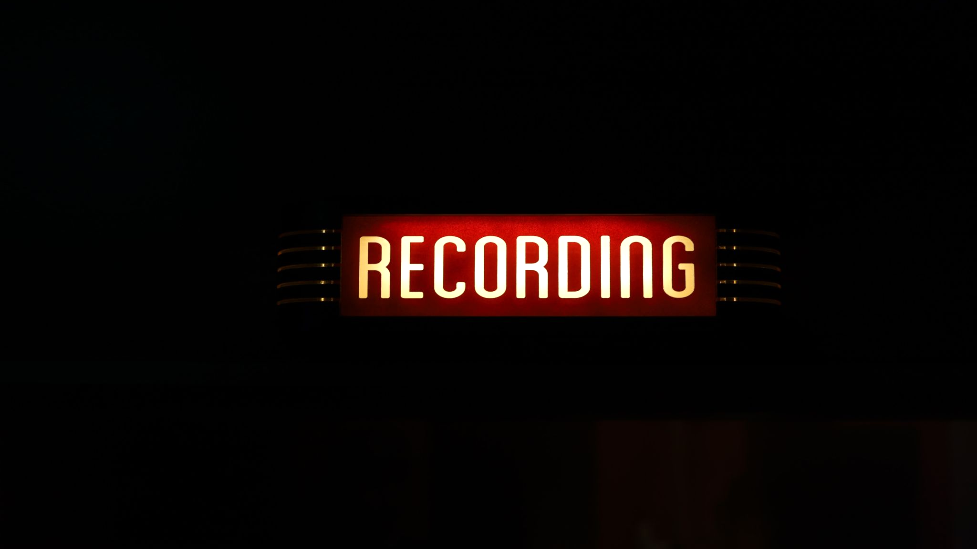

Slide 35

Questions?
JavaScript 1

